Slide 1
RTCQI E-TOOLS
Limont Lehman & Amanda Mohlala - SEAD
24 May 2024

Slide 2
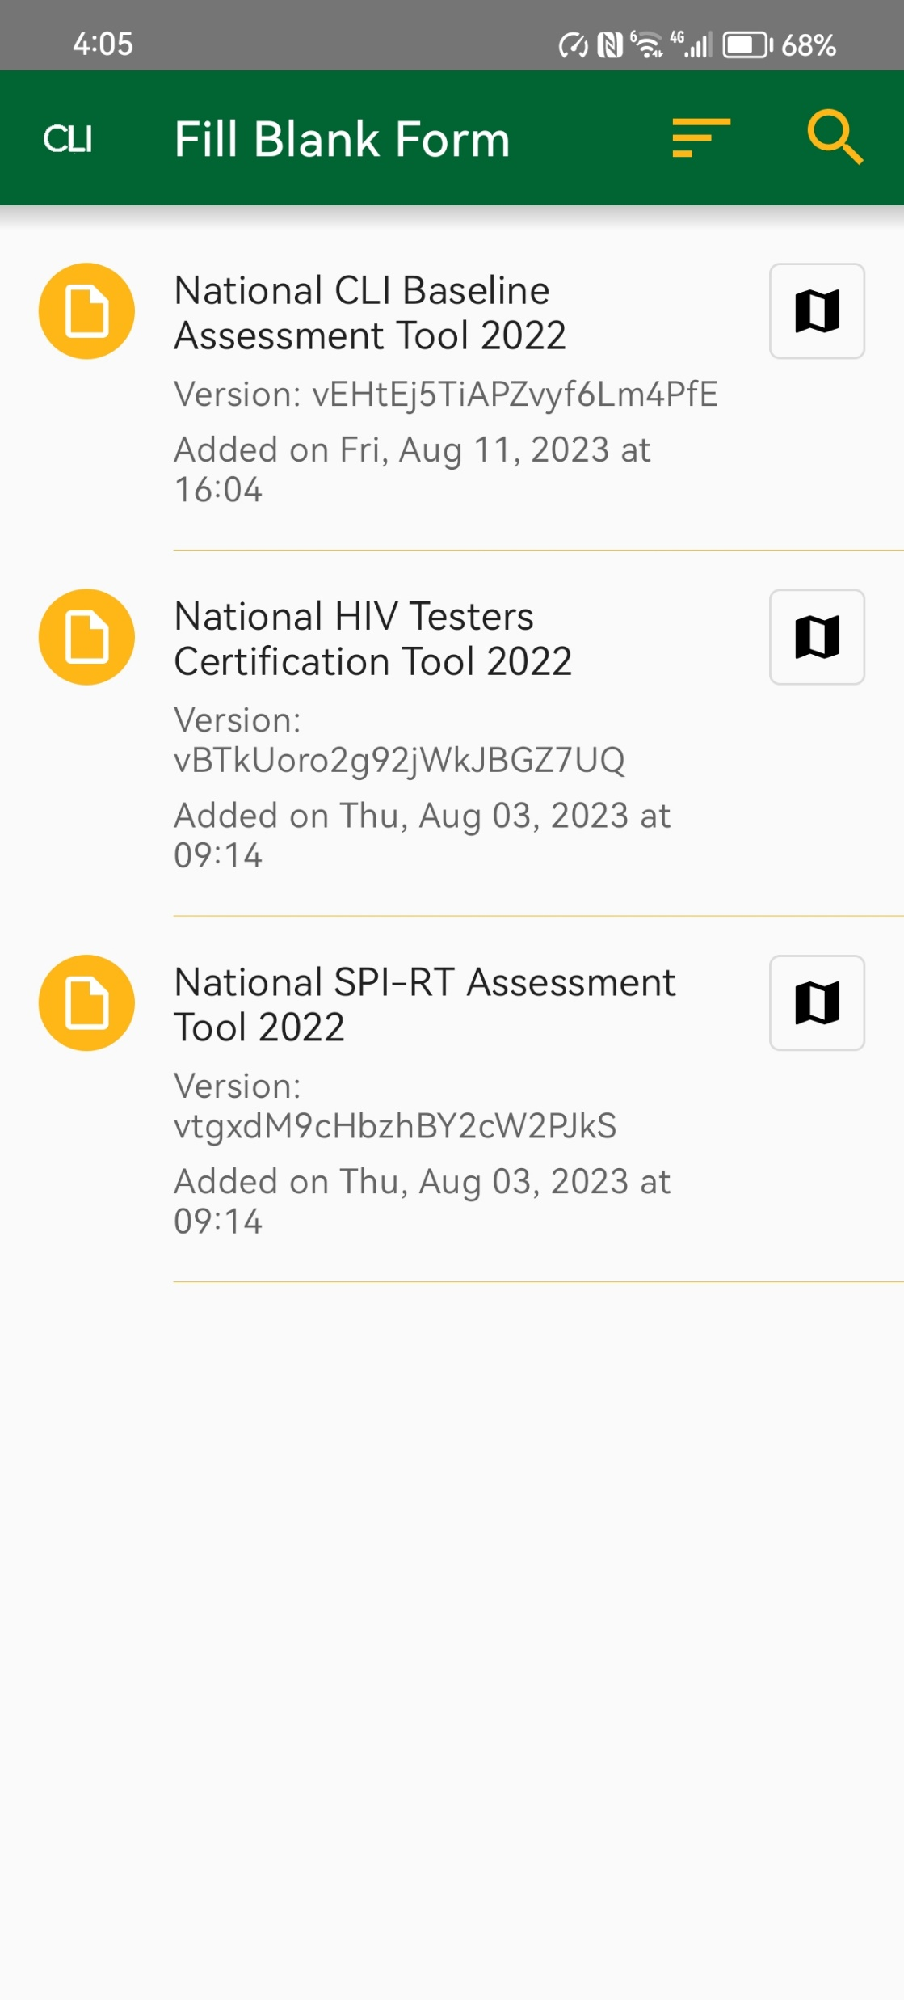
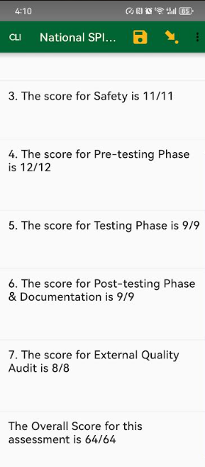
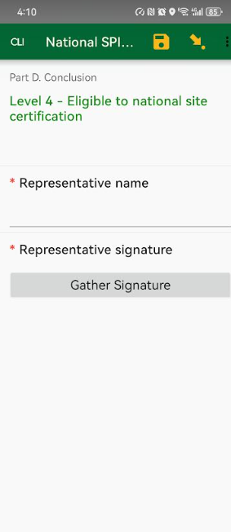
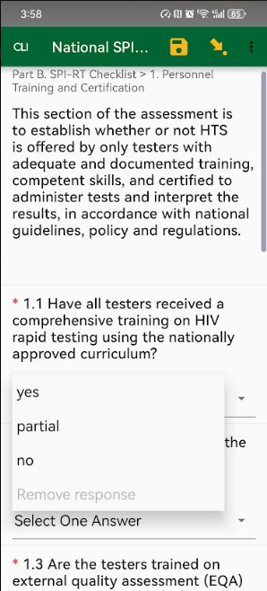
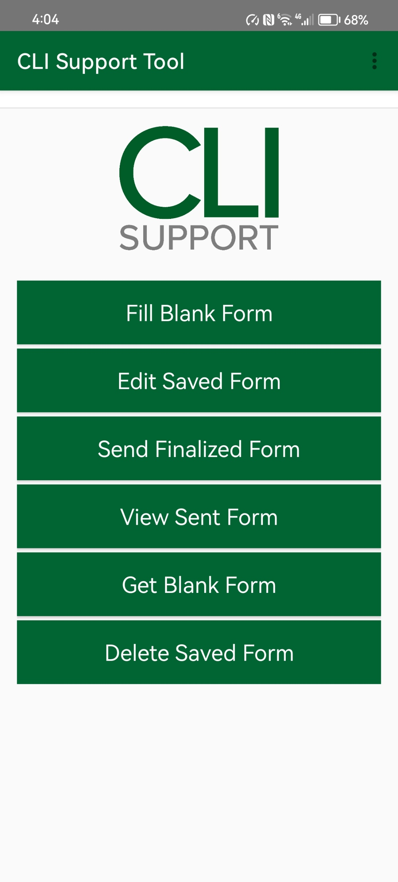
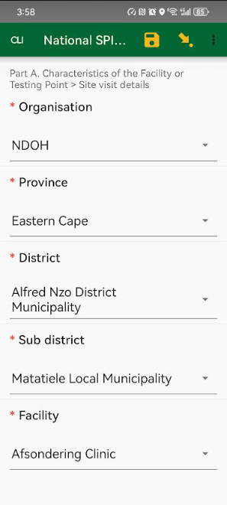
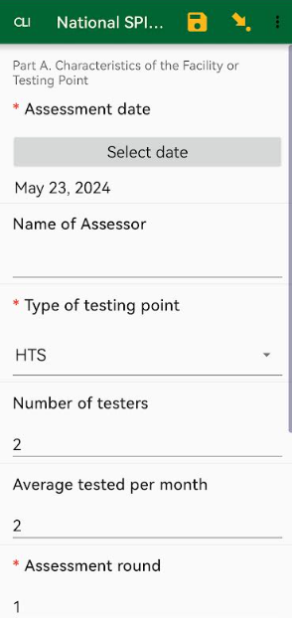
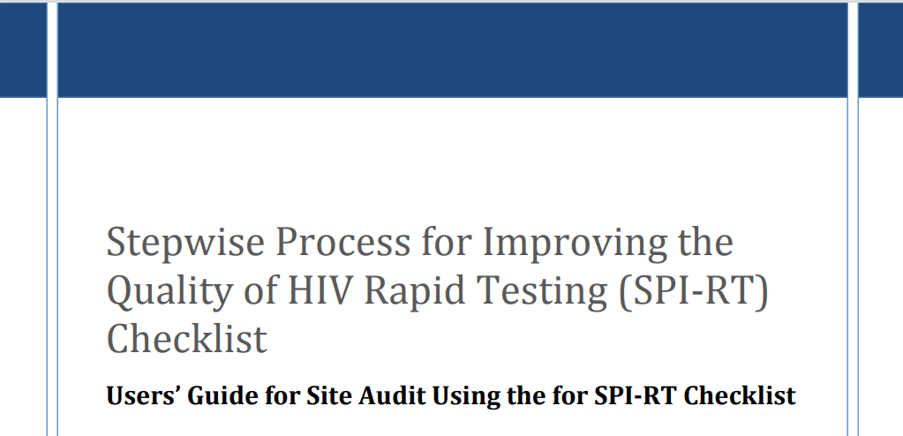
Audit tools
USED BY
NDOH
ANOVA
AURUM
BROADREACH
HST
MATCH
RIGHT TO CARE
SA PARTNERS
TB HIV CARE
WRHI
DCS
Total Users
DOH DSP
550+ 700+
Notes:
Summarize – bullet points add Open Source / Only Compatible with Android device.
Program roll out Nationally , a standardised branded app was created to support program objectives
SPI-RT was the main focus with external SPI-RT’s via the National Team

Slide 3
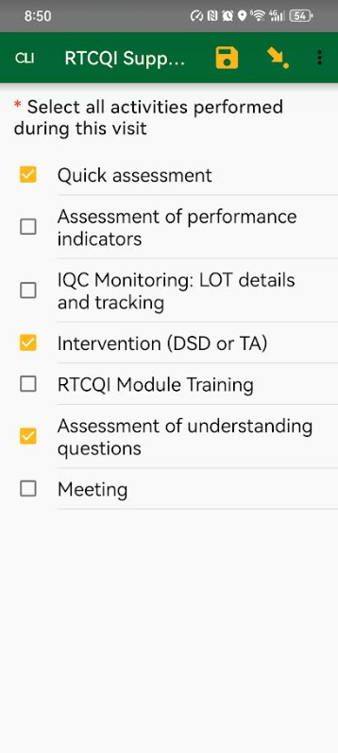
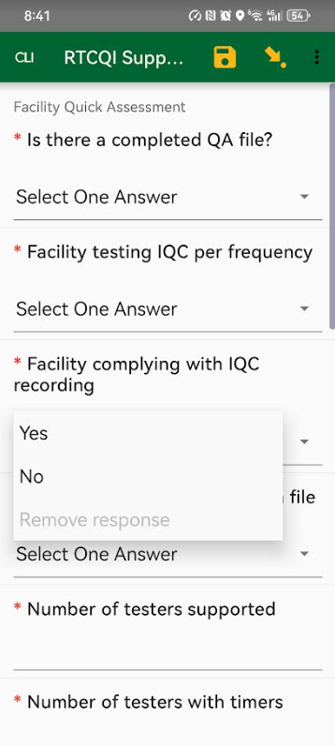
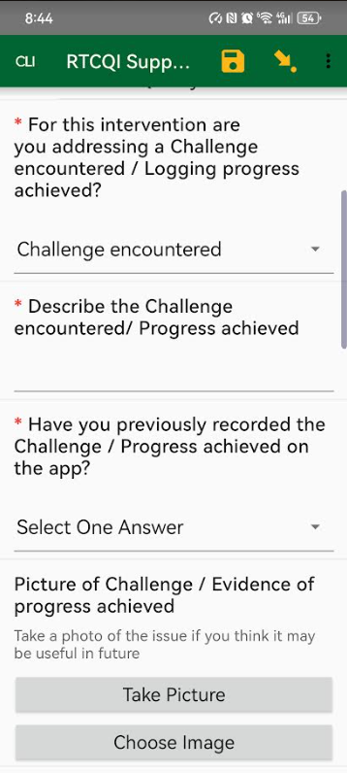
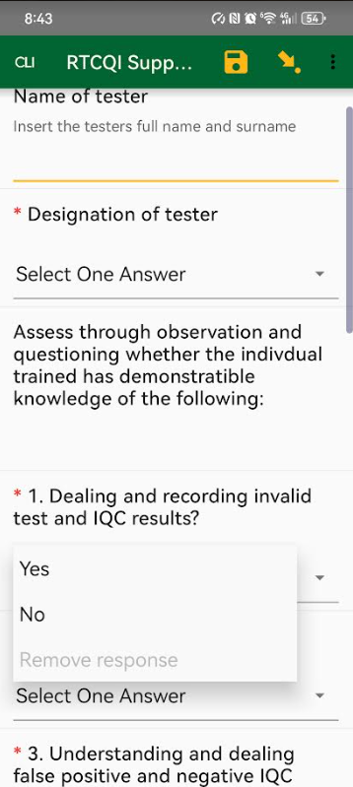
QA Intervention Tools
Notes:
Question-Based Assessments:
Dive deeper into challenges with targeted questions.
Action Documentation:
Record interventions and solutions.
Problem-Solving Techniques:
Mentor: Provide guidance and support.
Remind: Offer timely reminders.
Demonstrate: Show correct procedures.
Lend a Hand: Assist directly as needed.

Slide 4

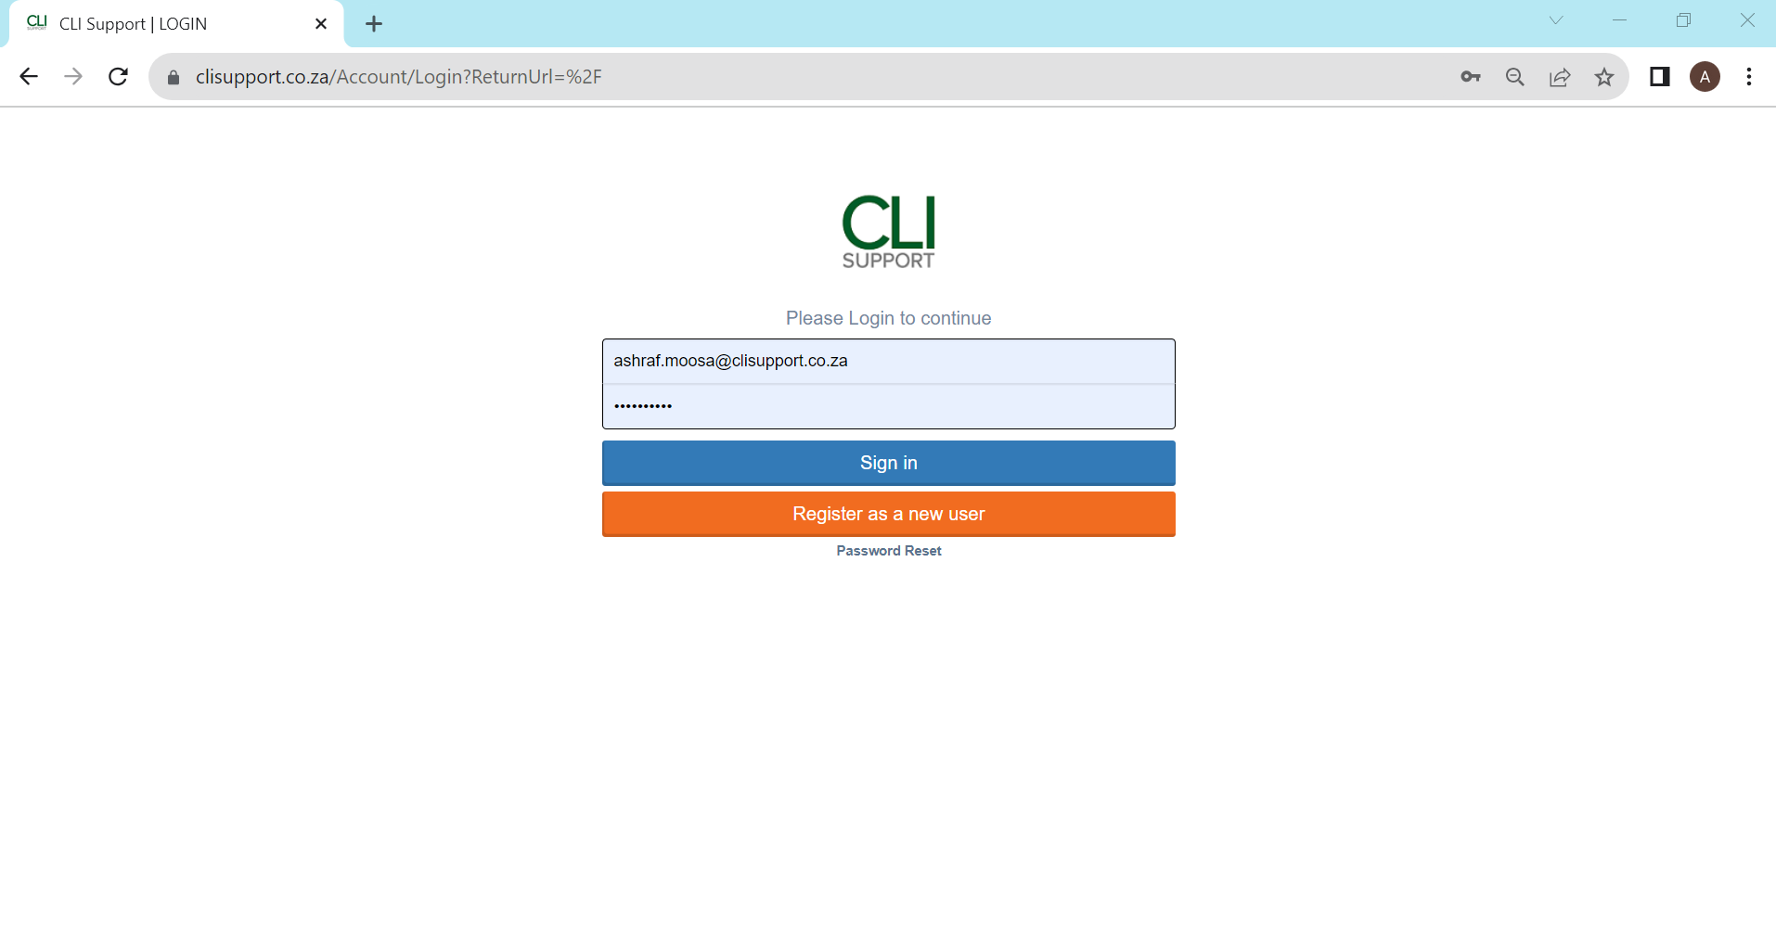
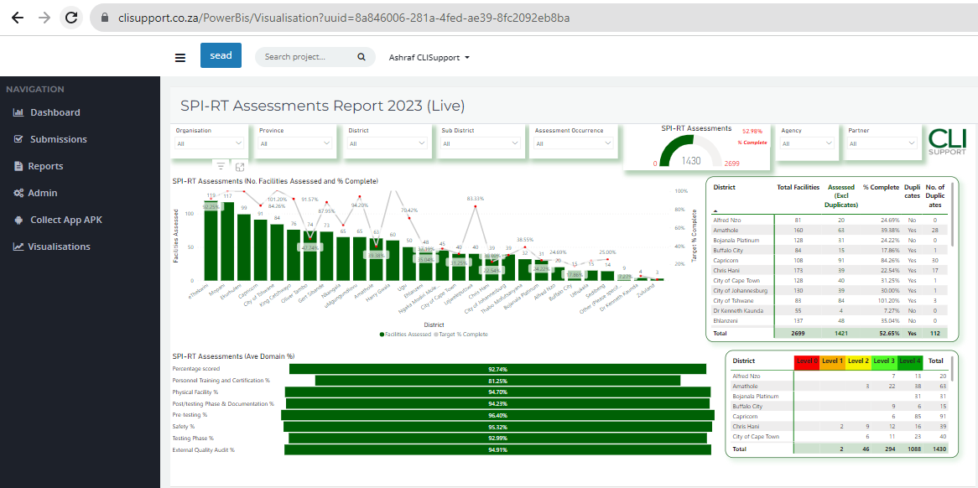
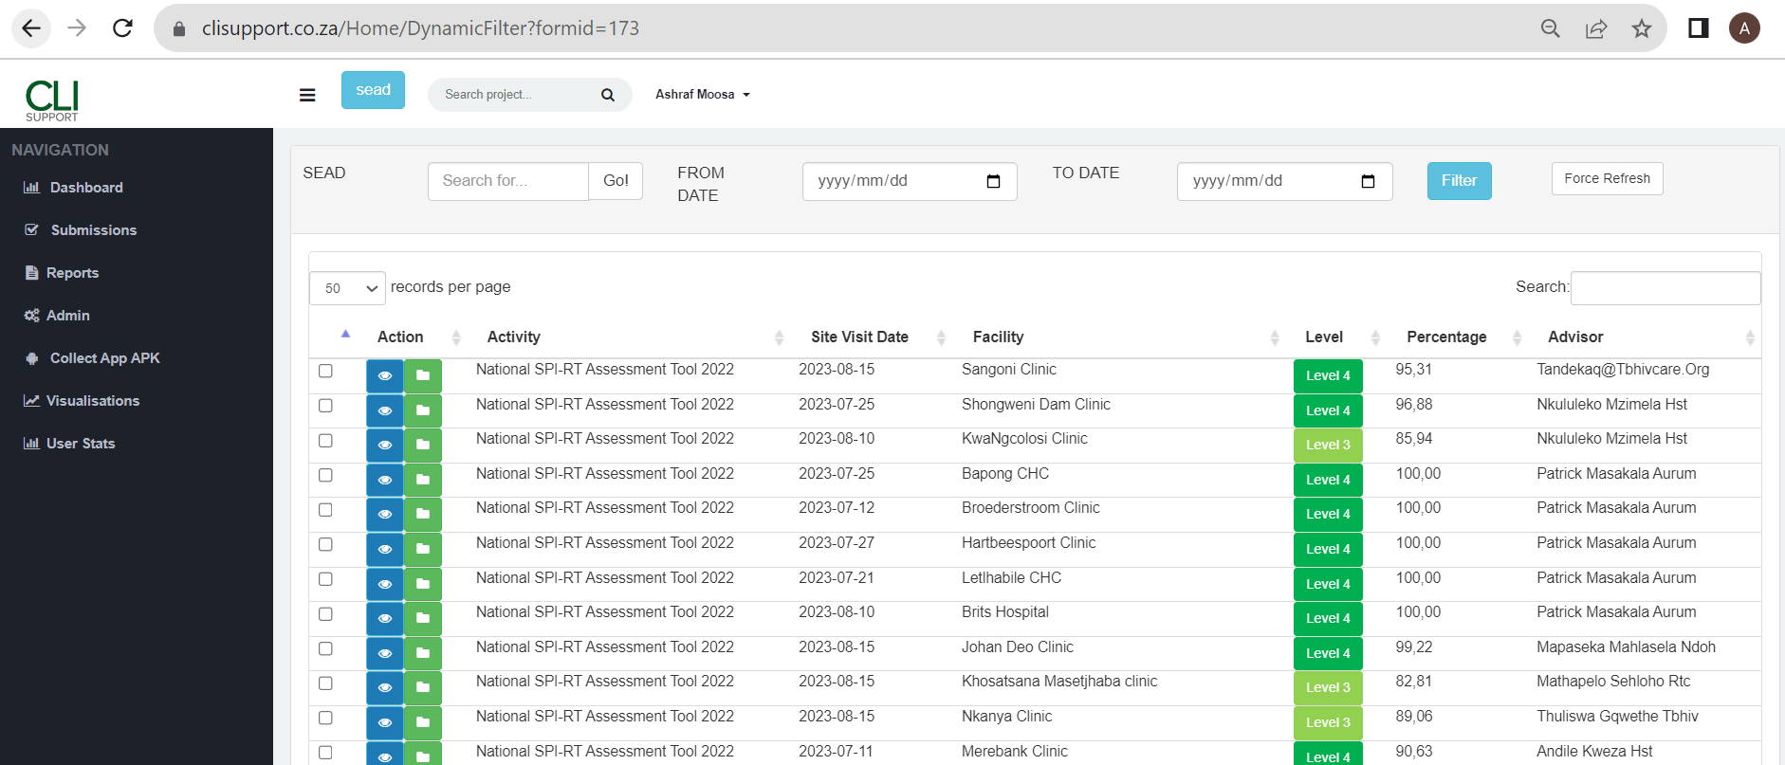
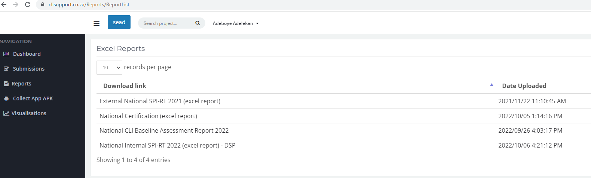

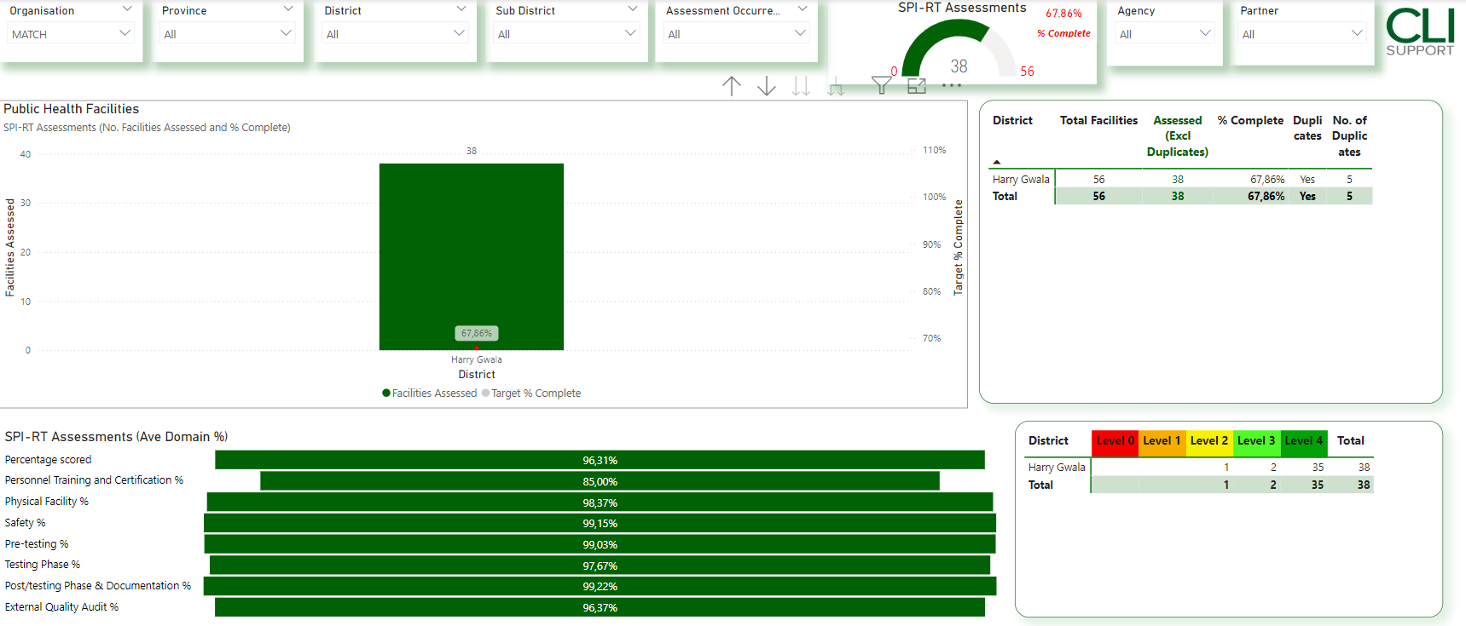
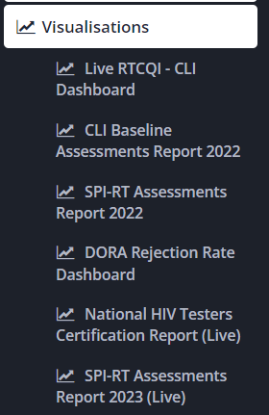

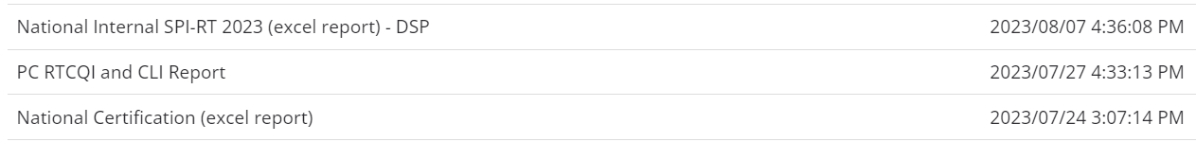

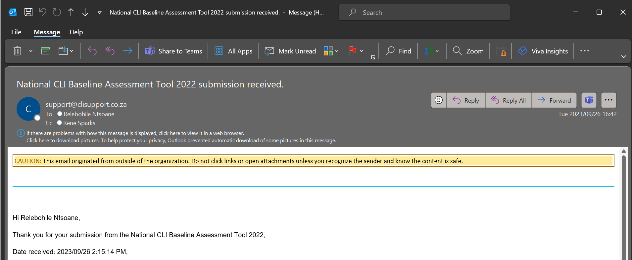
PROGRAM REPORTING PLATFORM
Online Tracking and Reporting - Personal
Submissions
Platforms Ability to :
Email notifications: Submissions and Report uploads
Check, edit and print field staff submissions of the various assessments
Visualisations to show progress/program monitoring (automated)
Downloading of excel reports
Notes:
Online tracking and reporting - Personal
- The app alone is not powerful and a platform had to be developed for submissions and tracking thereof.
feedback mechanisms to field staff
(post submission view, edit and confirm.
Team placement. But also printouts and email confirmations.

Slide 5
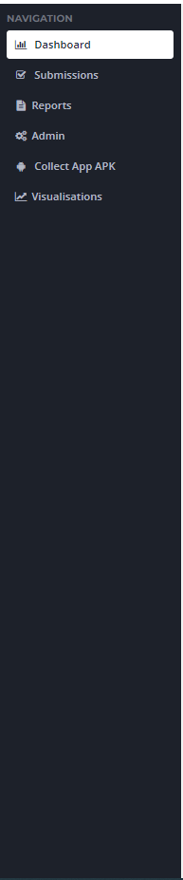
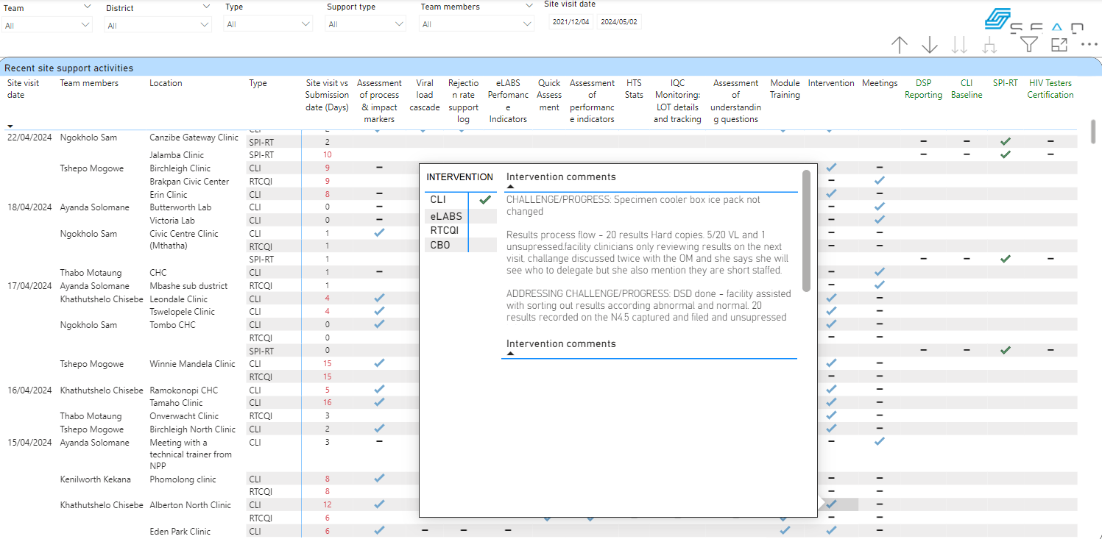
PROGRAM MONITORING
Online tracking and reporting - Management
Manage and support field staff

Slide 6
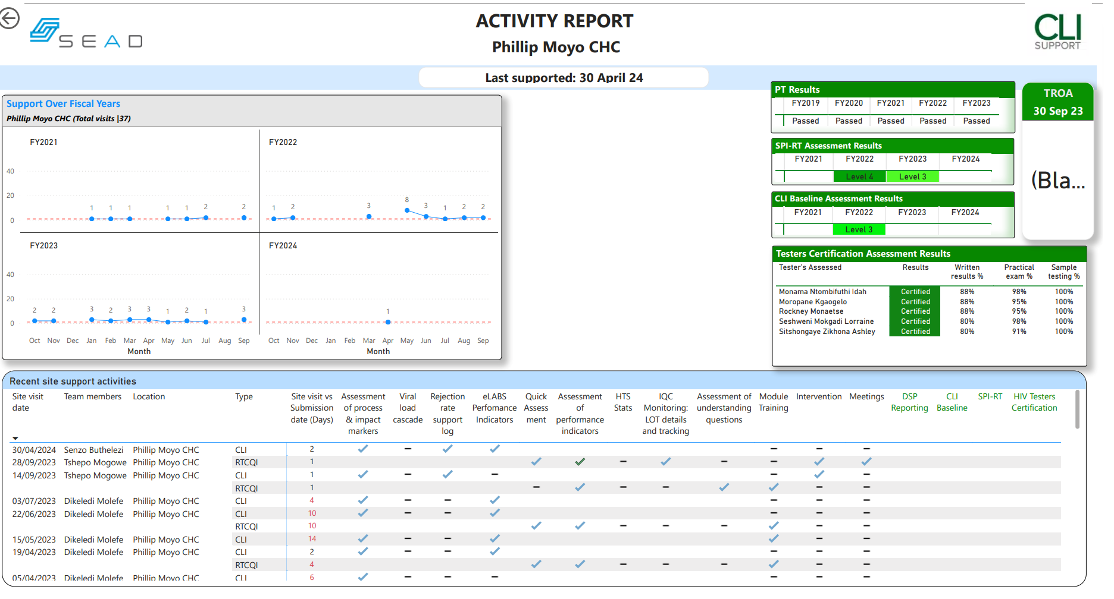
PROGRAM MONITORING
Online tracking and reporting - Management
Facility
5,021
Incorporate other datasets

Slide 7
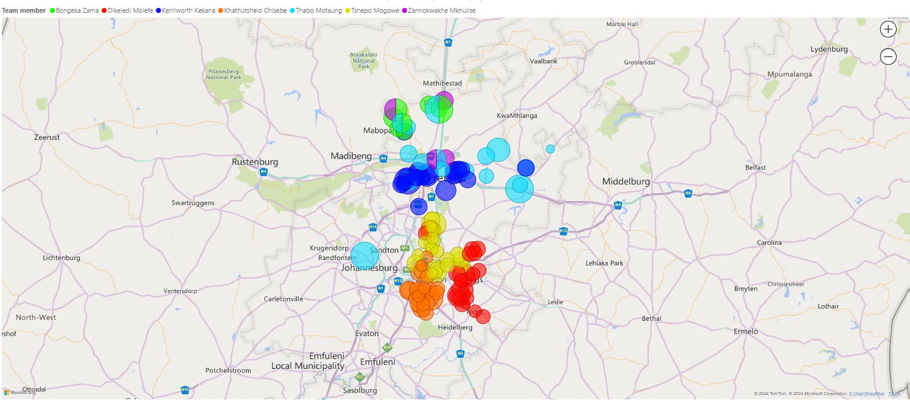
PROGRAM MONITORING
Online tracking and reporting - Management
Re-target and prioritise resources

Slide 8
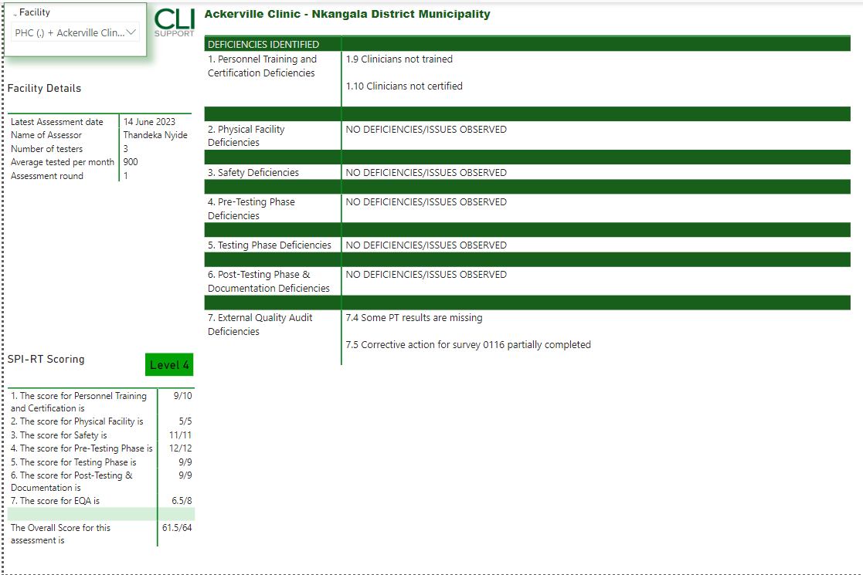
PROGRAM MONITORING
Online tracking and reporting - Management
SPI-RT Assessments
SPI-RT Assessments conducted
% Complete
Filter by Partner
Shows National Gradings achieved
DEFICIENCIES IDENTIFIED

Slide 9
PROGRAM MONITORING
Online tracking and reporting - Management
SPI-RT Assessments
SPI-RT Assessments conducted
% Complete
Filter by Partner
Shows National Gradings achieved
DEFICIENCIES IDENTIFIED

Slide 10
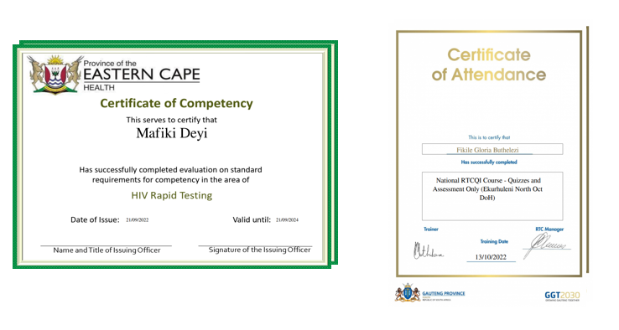
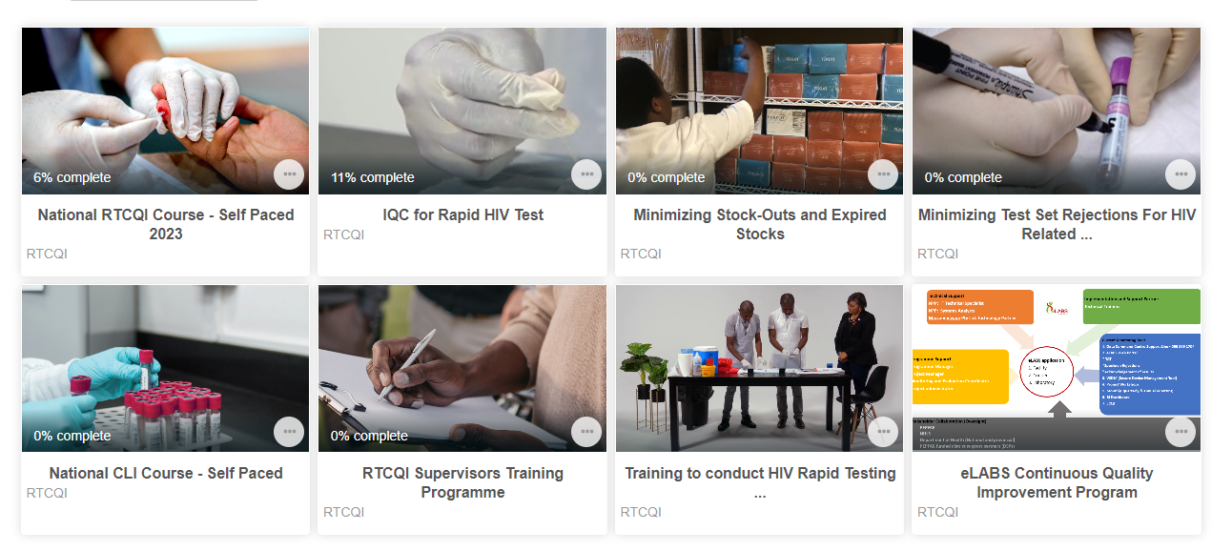
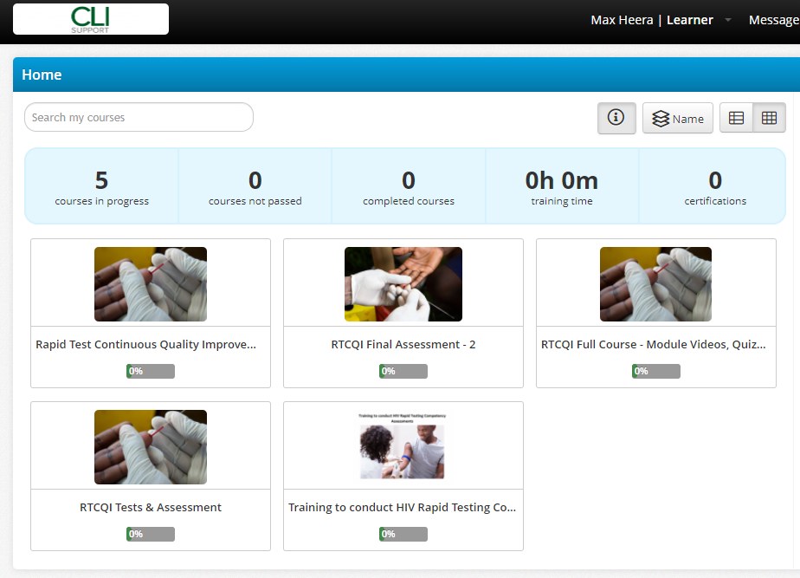
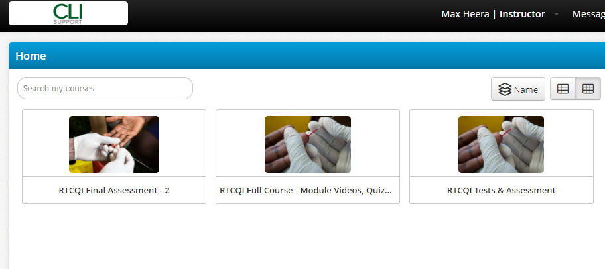
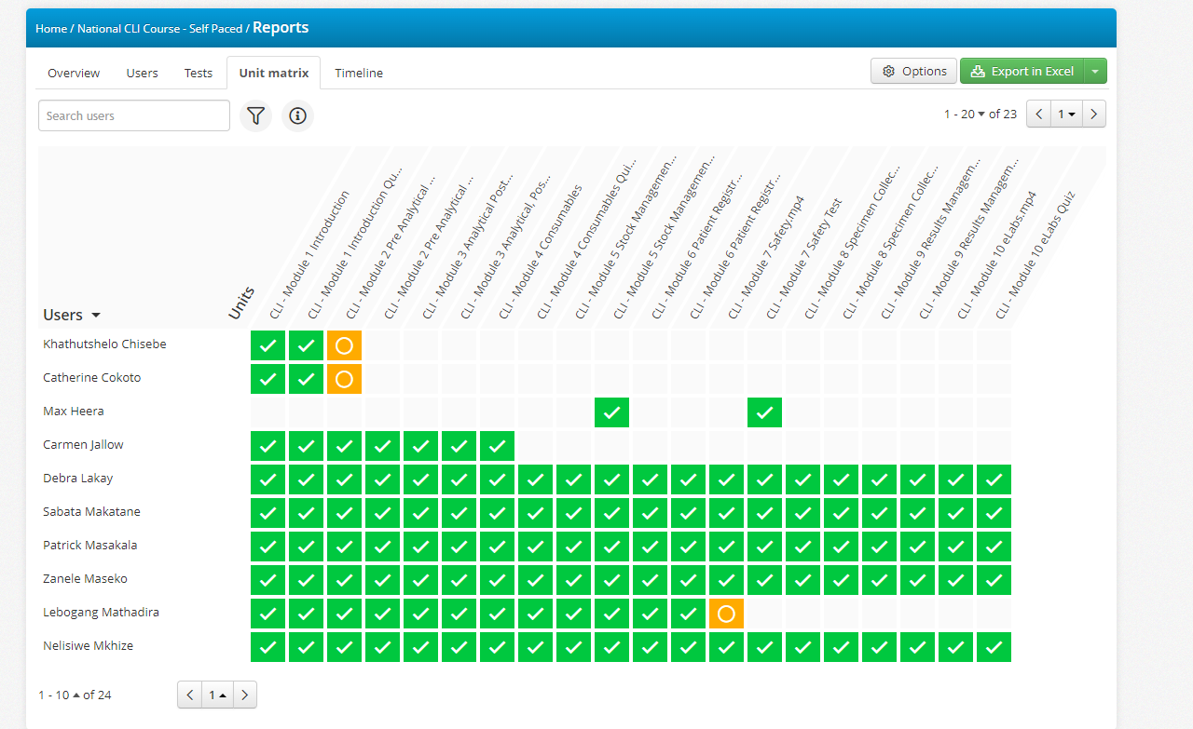

LEARNING MANAGEMENT TOOLS
Online Training and Reporting
LMS SYSTEM
Courses
Learner View
Instructor View
Progress Reports
Certificates of Completion

Slide 11


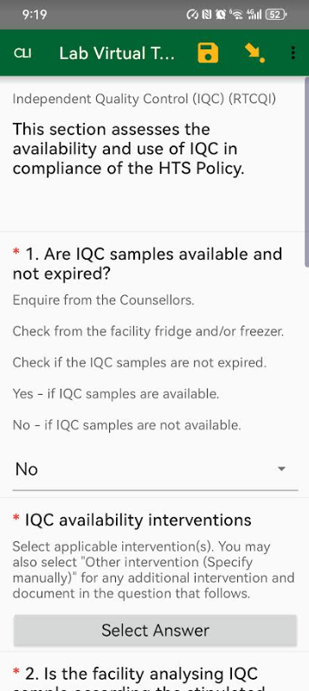
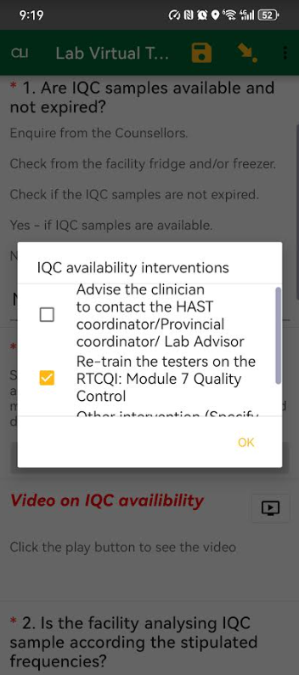
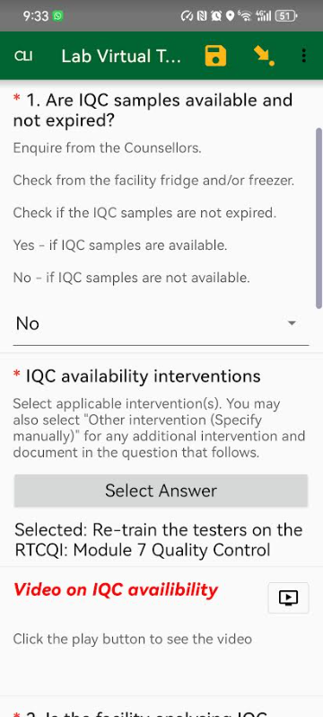
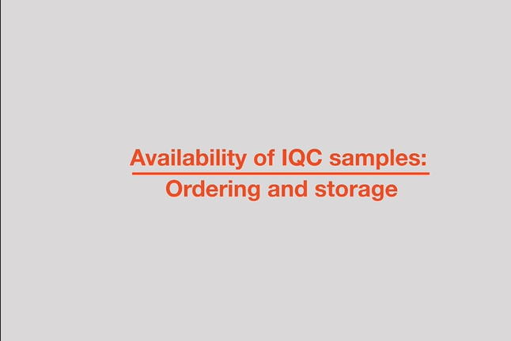
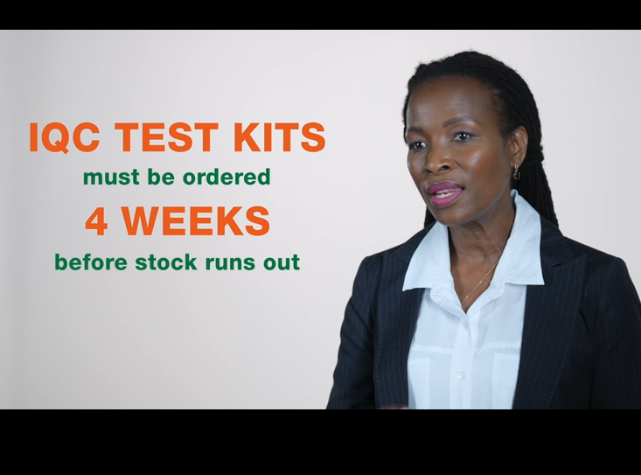
LEARNING MANAGEMENT TOOLS
Intervention and learning management is becoming integrated

Slide 12
SYSTEM SPECIFICS
Open-source
Platform agnostic / independent
Works offline
Accessible devices (Android) & laptop
Can be part of a hybrid system with paper-based legacy

Slide 13



THE FUTURE – Risk based assessments
Pinpoint root cause
Intervene in the moment
Generate systemic QIPs (Site and regional)
- Interventions are efficient, facility specific and action ready
- Use your existing HR resources and work routines

Slide 14

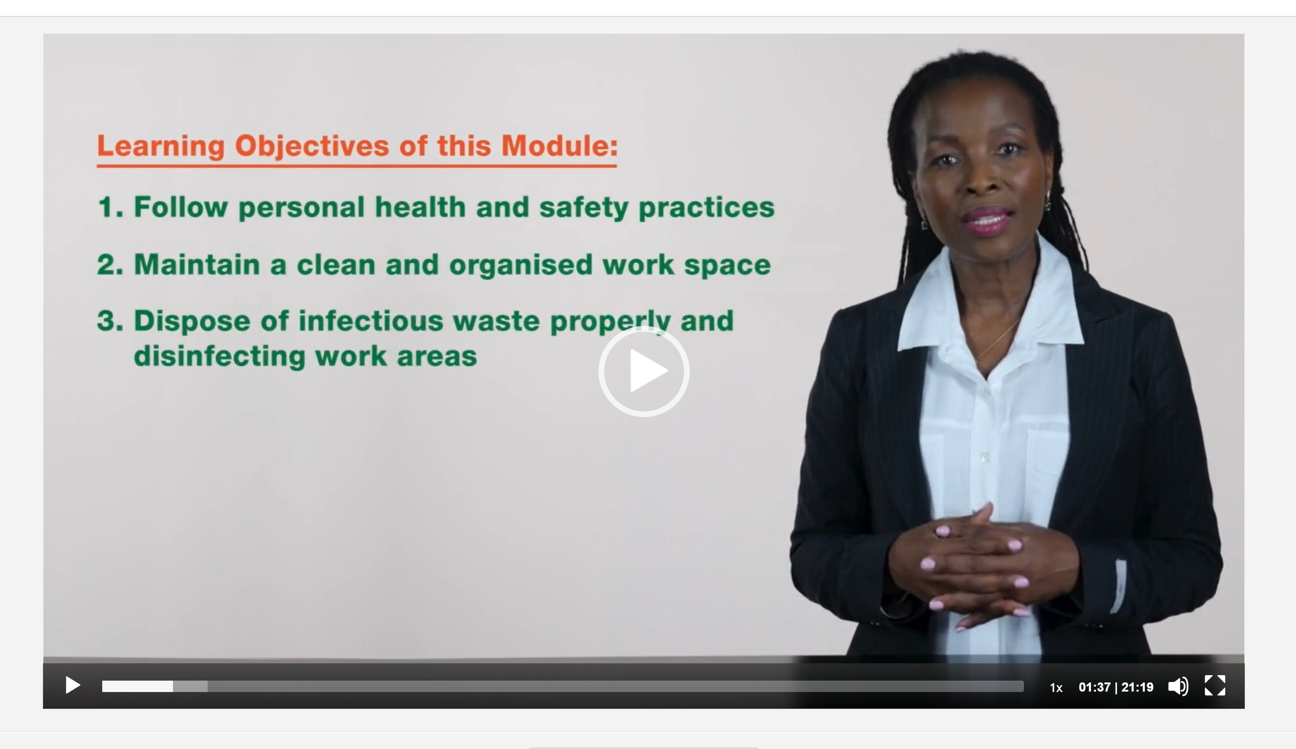


THE FUTURE – Automated QIPs
National External QA Audits
+
Generic, system level training
Facility specific, best-practice, Quality Improvement INTERVENTIONS

Slide 15
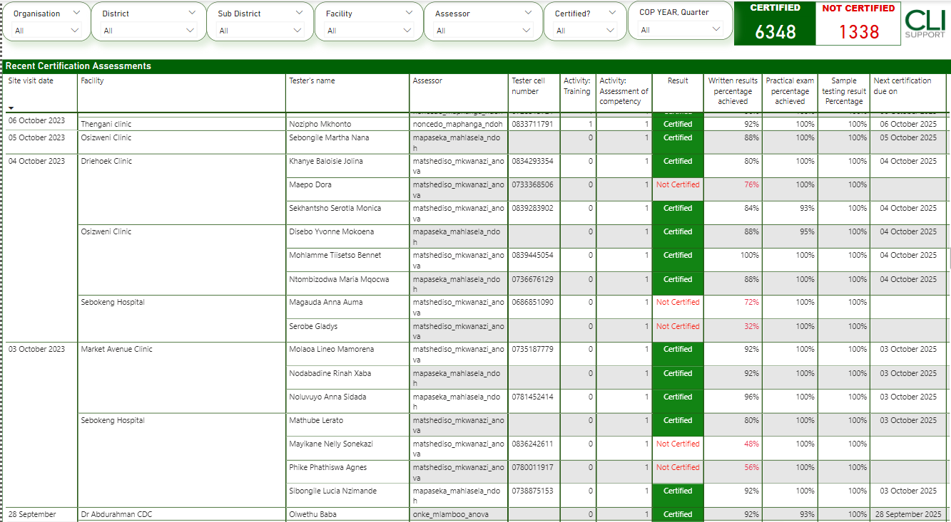





TESTER CERTIFICATION
LMS Course | Certification Assessment
Tester Certification
LMS RTCQI Course completion informs tester assessment
Resulting in database pre-qualified testers to be assessed F2F
Records which facility each tester is assigned to
Tracks when each tester needs re-certification

Slide 16
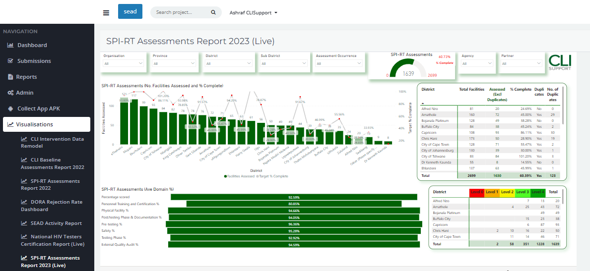
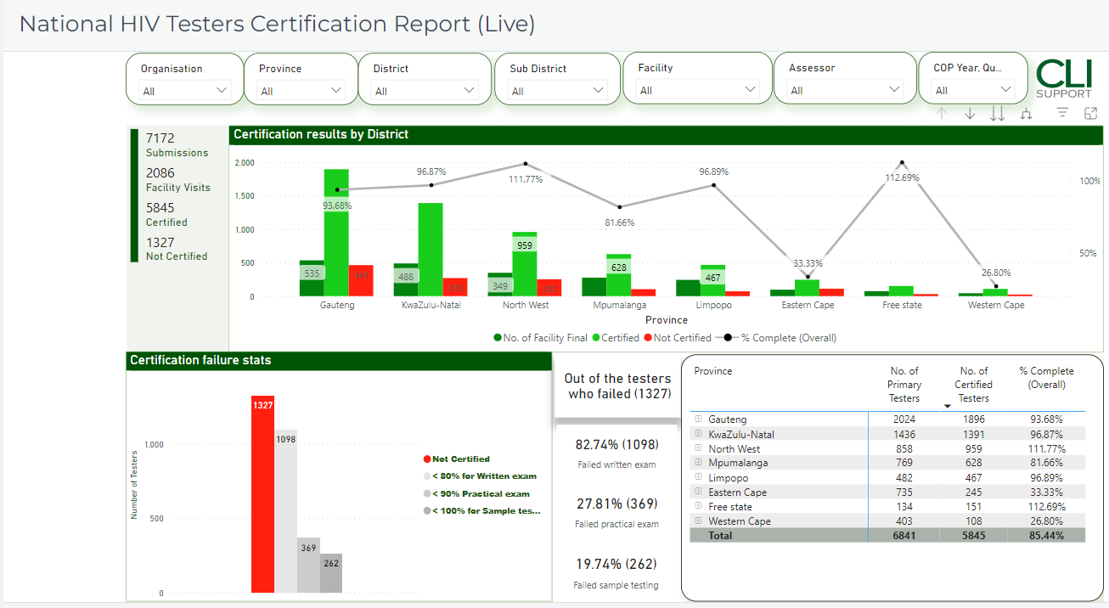
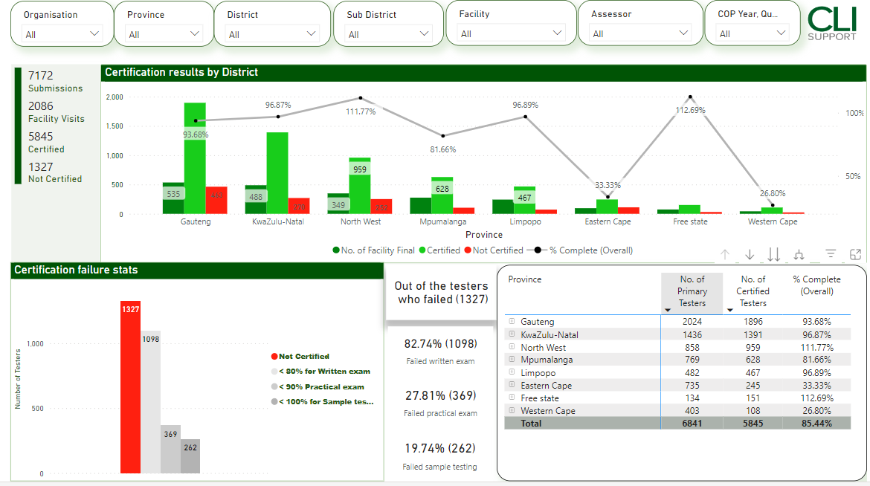
TESTER-CERTIFICATION
Online tracking and reporting - Management
National Tester Certification:
No. of Testers Certified
% Complete
Failure stats

Slide 17

Thank you

